Slide 1
Software Development with UML and Java 2
Design Pattern: Proxy

Slide 2
New questions about the Adapter pattern?
We’ll come back to it for the next assignment, Tuesday next week

Slide 3
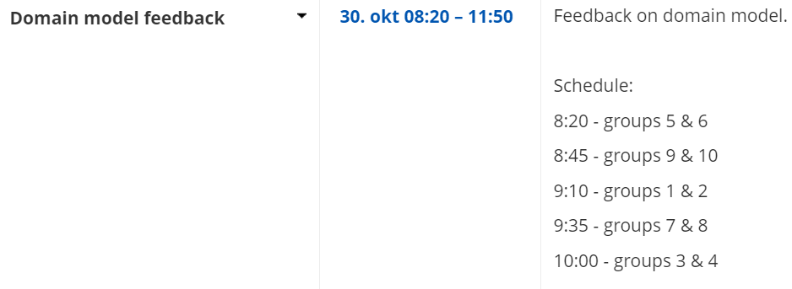


Slide 4
Plan
What is a proxy
Defining the Proxy design pattern
Proxy pattern structure
Examples of usage
In general
RMI
Image Viewer
Internet
Privilege restrictions
List of examples

Slide 5
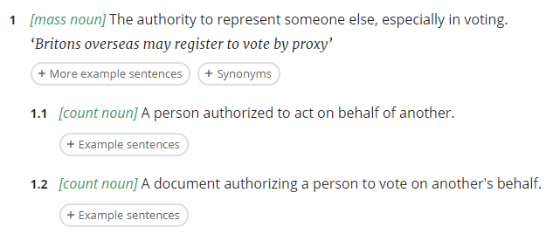
What is a proxy?
Oxford dictionary:
Representation of something else
Placeholder for something else
Substitute for something else
Something that acts on behalf of something else
Notes:
Dictionary definition of what a proxy is in general. This is included because a software proxy has similar responsibilities: a class acts on behalf of another class.

Slide 6
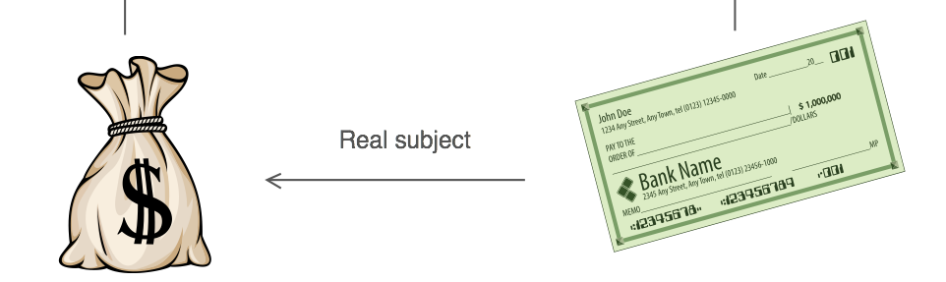
Design Pattern: Proxy
A class represents functionality of another class
It ‘wraps’ the other class.
Intent
Provide a placeholder or representative for another object to control access to it, or expand functionality
A wrapper to delegate work to a real subject.
Example
You need to support resource-hungry objects (time or memory consuming), and you do not want to instantiate such objects unless and until they are actually requested by the client (lazy instantiation).
You want to add extra functionality to an object, or change its behavior
You want to manage privileges
You need an object client side to represent an object server side
You’re trying to access a website, but a proxy first checks permissions.
Notes:
One usage is similar to the adapter pattern: Changing behavior of a class after it’s made, without changing that classes code. So you wrap the class in extra functionality, by introducing a Proxy class.
Another usage is when you have a class with some “base functionality”, and you want to apply different extra functionality on different occasions. Then this extra functionality can be done with a proxy, which then also uses the original’s functionality.

Slide 7
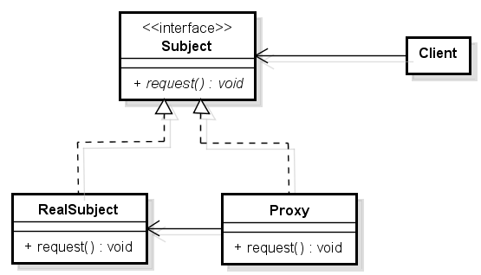
Design pattern: Proxy
Proxy has an instance of RealSubject
Delegate to another class
implementing the same interface
System
Notes:
The structure of the proxy pattern. The RealSubject is the initial class, and we wrap its functionality in a Proxy class. So the Proxy class will do “something”, and then the let the RealSubject do the rest.
They share an interface, because the idea is that the rest of the system doesn’t need to know, whether it’s using a RealSubject or a Proxy.

Slide 8
When coding
You have something existing, and you wrap it in extra functionality.

Slide 9
Plan
What is a proxy
Defining the Proxy design pattern
Proxy pattern structure
Examples of usage
In general
RMI
Image Viewer
Internet
Privilege restrictions
List of examples

Slide 10
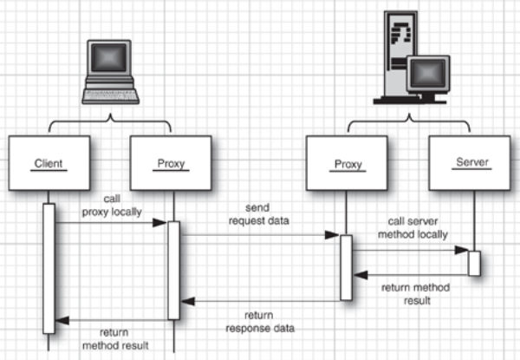
RMI
The interface the client interacts with is a proxy for the server
Notes:
RMI uses the proxy pattern. We don’t really see this, but when the client has an interface of the server, the client will call a method on the interface, which is implemented by a Proxy on the client side. The Proxy will then make the call to the RealSubject on the server side, i.e. the actual Server class. This happens through another Proxy on the server side, so we have two proxies in place here. There responsibility is to make the network connection.

Slide 11

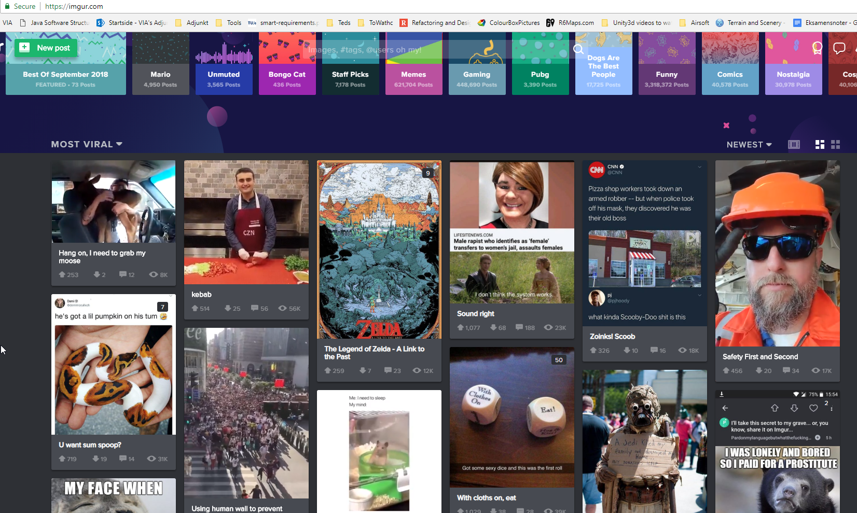
Example
You have a program that handles a lot of Image objects (the resource hungry objects).
Even though a lot of Image objects are loaded into the program, you usually only need to look at a few.
We waste resources on the images that we never look at, if we load these initially.
Think imgur.com frontpage, or Instagram

Slide 12


Example: Image viewer
Image 1
Image 2
Image 3
Image 4
Image 5
Image 6
Image 7
Maybe thousands of images
Image 8
Image 9
Image 10
Notes:
In my image viewer program I can have thousands of images. Each could be represented by a button, or a thumbnail: a very scaled down version of the image.
I don’t want to load all images into the program initially, that would quickly fill out my RAM.
Instead I have a “representative” for each image: the button/thumbnail. These are low-cost in memory terms. When clicking on an image, the real image is loaded.

Slide 13
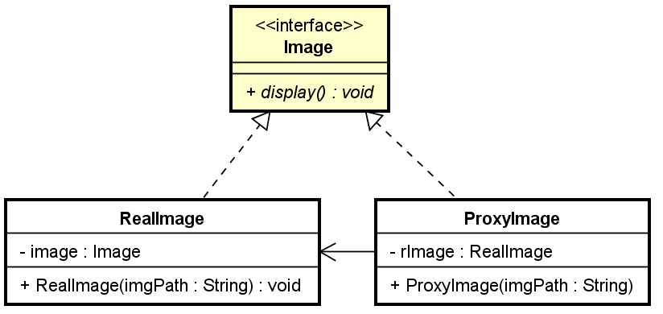
Proxy Image
So that the program doesn’t need to care whether it’s the real image or the proxy
Create a class to handle the Image
Create a class to be the proxy for that image.
They must share the same interface
Notes:
We use the Proxy pattern structure here

Slide 14
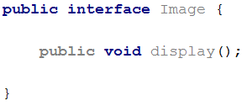
Proxy Image Example
public class RealImage implements Image {
private String fileName;
private Image image;
public RealImage(String fileName){
this.fileName = fileName;
loadFromDisk(fileName);
}
@Override
public void display() {
System.out.println("Displaying " + fileName);
}
private void loadFromDisk(String fileName){
System.out.println("Loading " + fileName);
}
}
As soon as the image is created, it is loaded into memory
Notes:
The RealImage will initially load the image upon construction. So when this is object is created, it will take time to load the image, and it will consume a bunch of memory.
The display method is supposed to then show the image on the right side of my program. In my example, I just print out my intention to simplify stuff.

Slide 15
Proxy Image Example
public class RealImage implements Image {
private String fileName;
private Image image;
public RealImage(String fileName){
this.fileName = fileName;
loadFromDisk(fileName);
}
@Override
public void display() {
System.out.println("Displaying " + fileName);
}
private void loadFromDisk(String fileName){
System.out.println("Loading " + fileName);
}
}
public class ProxyImage implements Image {
private String fileName;
private RealImage realImage;
public ProxyImage(String fileName){
this.fileName = fileName;
}
@Override
public void display() {
if(realImage == null){
realImage = new RealImage(fileName);
}
realImage.display();
}
}
Lazy Instantiation
Notes:
The proxy image only loads the image, when it’s actually needed. All methods you are able to call on the RealImage, you should also be able to call on the ProxyImage, where the ProxyImage just forwards the method call to RealImage.

Slide 16

Example: Image viewer
Each button represents an Image object
Could use RealImage objects, or ProxyImage objects to save resources
ProxyImage could also have an unload-method, to explicitly clear the image from memory
Image 1
Image 2
Image 3
Image 4
Image 5
Image 6
Image 7
Image 8
Image 9
Image 10

Slide 17


Slide 18
Plan
What is a proxy
Defining the Proxy design pattern
Proxy pattern structure
Examples of usage
In general
RMI
Image Viewer
Internet
Privilege restrictions
List of examples

Slide 19
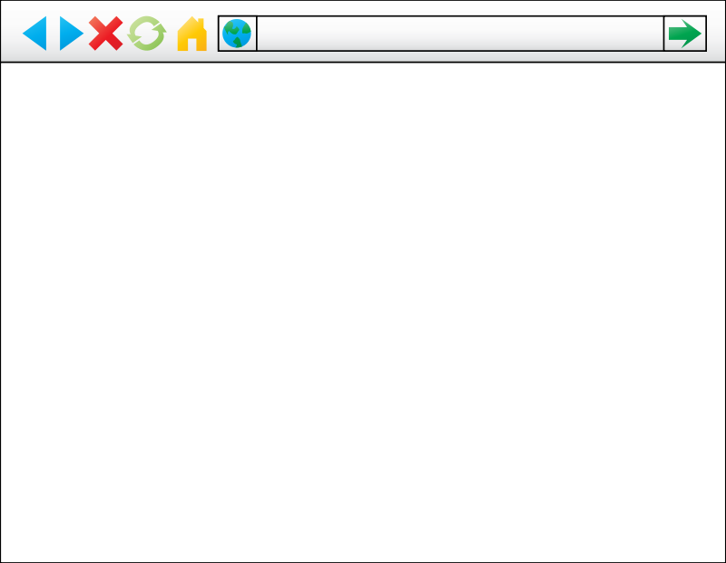
Internet example, use proxy to manage access
Internet
thepiratebay.org
Access naughty website

Slide 20
Internet example, use proxy to manage access
Internet
thepiratebay.org
Access naughty website
Proxy

Slide 21
Internet example, use proxy to manage access
Internet
thepiratebay.org
Access naughty website
Proxy
Access denied

Slide 22
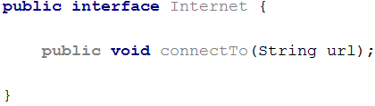
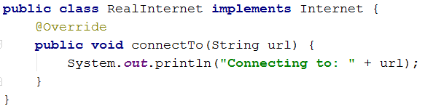
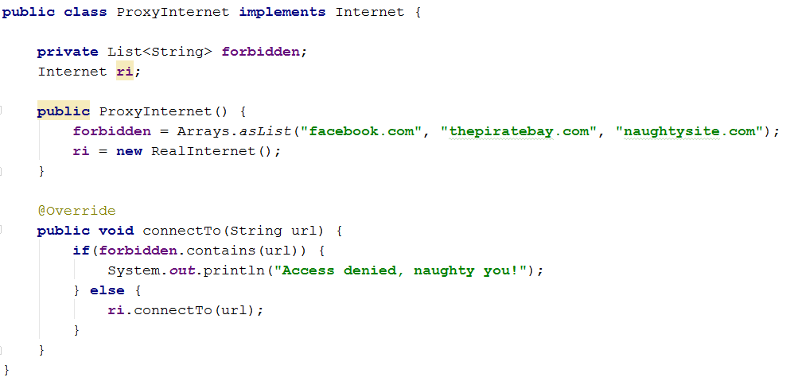
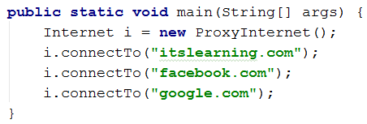
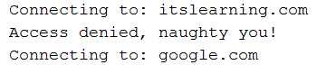

Slide 23


Slide 24
GUI restrictions example
This could be a text field displaying some text, perhaps a very interesting and thought-provoking statement. But probably not.
Do stuff
Do other stuff
Maybe do stuff?
This will probably do stuff
Logic is performed in the Model

Slide 25
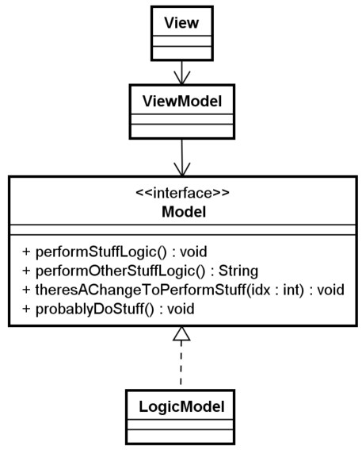
GUI restrictions example
This could be a text field displaying some text, perhaps a very interesting and thought-provoking statement. But probably not.
Do stuff
Do other stuff
Maybe do stuff?
This will probably do stuff
Logic is performed in the Model

Slide 26
GUI restrictions example
This could be a text field displaying some text, perhaps a very interesting and thought-provoking statement. But probably not.
Do stuff
Do other stuff
Maybe do stuff?
This will probably do stuff
Do fancy stuff
Maybe some users are allowed to use some buttons, while other users are not.
Or you need the admin password

Slide 27
GUI restrictions example
This could be a text field displaying some text, perhaps a very interesting and thought-provoking statement. But probably not.
Do stuff
Do other stuff
Maybe do stuff?
This will probably do stuff
Do fancy stuff
We could change the Model’s functionality
Or we could create a proxy to handle user privileges

Slide 28
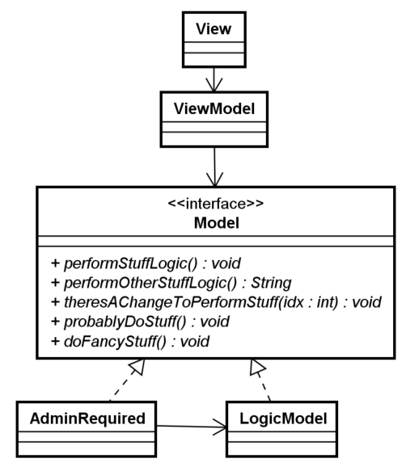
GUI restrictions example

Slide 29
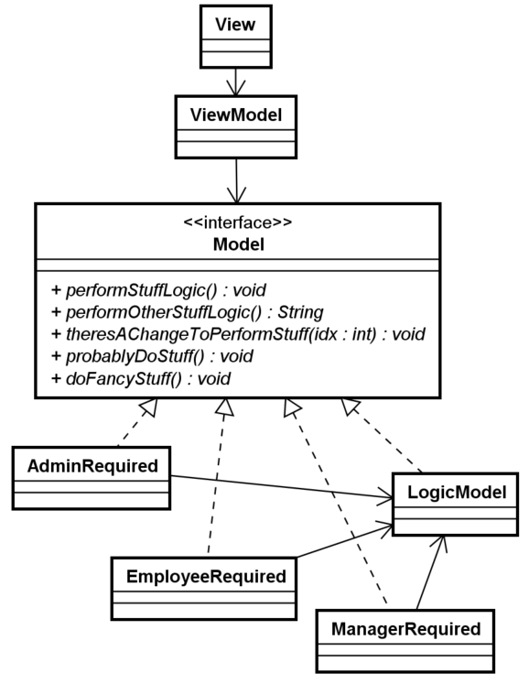
GUI restrictions example

Slide 30
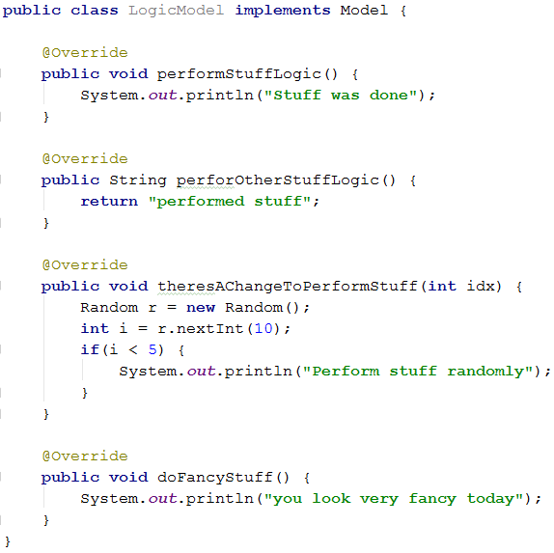
public class EmployeeRequired implements Model{ private LogicModel lm; private User currentUser; public EmployeeRequired(LogicModel lm, User user) { this.lm = lm; currentUser = user; } @Override public void performStuffLogic() { lm.performStuffLogic(); } @Override public String perforOtherStuffLogic() { return lm.perforOtherStuffLogic(); } @Override public void theresAChangeToPerformStuff(int idx) { if(currentUser.getAccessLevel() > 4) { lm.theresAChangeToPerformStuff(idx); } else { throw new RuntimeException("Access denied"); } } @Override public void doFancyStuff() { if(currentUser.getAccessLevel() > 7) { lm.doFancyStuff(); } else { throw new RuntimeException("Access denied"); } } }

Slide 31


Slide 32
Plan
What is a proxy
Defining the Proxy design pattern
Proxy pattern structure
Examples of usage
In general
RMI
Image Viewer
Internet
Privilege restrictions
List of examples

Slide 33
Proxy
When the original object creation is expensive (lazy instantiation, much memory or long time)
When the original object exists in a remote environment
When there are restricted security controls on the original object
When there is need of performing additional operations before or after the creation of the original object: pre-processing or post-processing.
Override/modify/change/skip functionality
Caching data (instead of getting from database/server every time, store data in cache in proxy)

Slide 34
Rest of system
Object

Slide 35
Wrapping some code in extra functionality
Rest of system
Proxy
Object

Slide 36


Slide 37

Back to working on those exercises

